Slide 1
Lab 2 Understanding As-Is Business Process
IS210 – Business Process Analysis and Solutioning

Slide 2
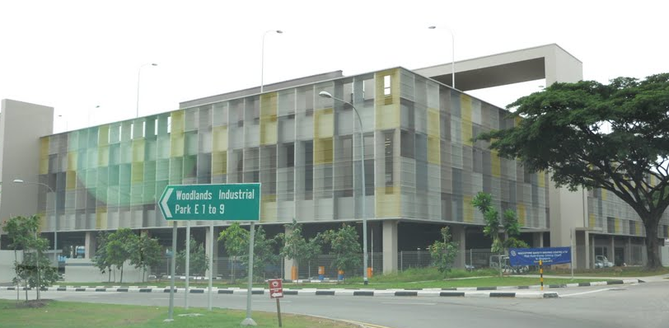
StarMall Company Background
StarMall is Singapore’s leading provider of industrial space solutions
The company is renowned for its industrial parks and has several developments in in the western region of Singapore

Slide 3
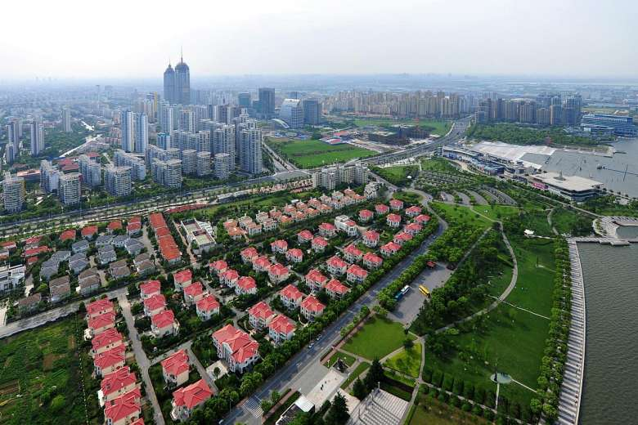
Suzhou Industrial Park
StarMall Company Background
Other Industrial Parks

Slide 4
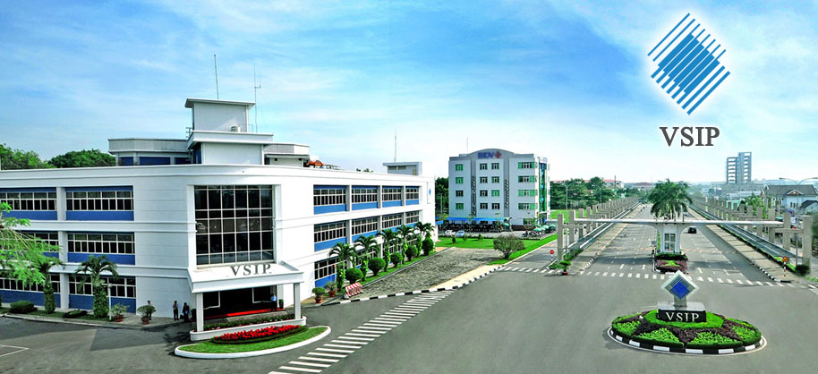
StarMall Company Background
Other Industrial Parks
Vietnam Industrial Park

Slide 5
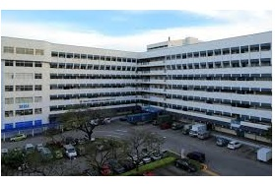
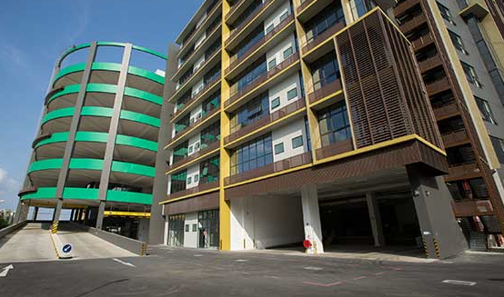
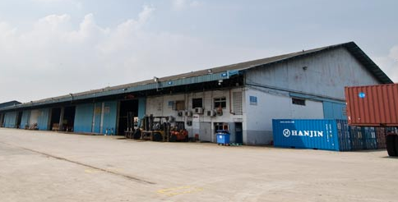
StarMall Company Background
StarMall markets a variety of industrial spaces such as warehouses, flatted factories and ramp-up factories for rental to light-industry players
flatted factories
ramp-up factories
warehouses

Slide 6
StarMall Company Background
There are many business processes in StarMall, the Business Process Engineering (BPE) team has been tasked to study and suggest improvements to the Rental Application process only

Slide 7
Interview Transcripts
Login to eLearn, download and refer to
‘Lab 2 - Understanding As-Is Business Process.pdf’

Slide 8
Exercise – What you need to do?
Study StarMall Company Background (Part 1) and the Interview Transcripts (Part 2) with your BPE team on the StarMall Rental Application process

Slide 9
Exercise – What you need to do?
Briefly describe the users/roles and IT applications involved in the StarMall Rental Application process.
Develop the Resource Model for the StarMall Rental Application process
Rearrange the steps for the StarMall Rental Application process and indicate the execution timing of each task.
Develop the Collaboration Model for the StarMall Rental Application process.

Slide 10
Exercise (A) – Roles and IT Applications
Role/Resource | Short Description
Briefly describe what they do… working hours, etc

Slide 11
Exercise (B) – Resource Model
Identify Who is involved
Identify Who is involved
Identify Who is involved
Identify Who is involved
Notes:
Additional Slides to explain what the student need to do

Slide 12
Exercise (C) – Detailed Step by Step Process
State the order sequence for the StarMall Rental Application process
Activity Step | Previous Step(s) | Activity/Task Description | Execution Time (min)
4 | 3a | XXXX…….. | 12
8 | 7 | YYYYY…. | 10
. . . |  | . . .
10 | 9 | ZZZZZ….. | 15
Indicate time taken; combine tasks with single given time
Notes:
Additional Slides to explain what the student need to do

Slide 13
Exercise (D) – Collaboration Model Information
Collaboration
Model
Non-Complex Model
Complex
Model
Process Package
Model
For every Process
Process Workflow
Model

Slide 14


Exercise (D) – Collaboration Model
Segment by for e.g. depts., functions
IT Systems: Park together with business owner
Segment A
Segment B
Segment C
Numbering is not time-dependent; just used to indicate multiple interactions
RoleA’s rejection reason for choices
RoleA’s selected choice space details
aaaaaaa
xxxxxxxxxx
yyyyyyyyyyyy
SystemA
ROLE A
ROLE B
Filled Form Z
Interactions : Single-directional arrows are clearer
Work Product: Use nouns,
not verbs
Filled Form Z
ROLE C
Name must be consistent
Roles, eg: Business Owner

Slide 15
Exercise – Submission by team
Submit (1zip file per project group/team) the following to eLearn Lab2 - GX Assignment Submission folder (where X is your section number).

